Slide 1

Inclusive Leadership:
Working with Respect and Dignity
University Equality, Diversity and Inclusion Policy

Slide 2

Strategy 2035
We are one team and we are best when we are together.
Mission:
Developing people: We develop
the skills and capabilities of our students
and staff, embrace diversity and further career success
Values and behaviours:
Inclusive: We are welcoming,
respectful, collegiate and supportive.
People and culture:
We attract, develop and retain
talented people by embedding
an inclusive, empowering and
supportive culture.
Outcomes:
Attracting, developing and
retaining talented and motivated
staff
Notes:
Font Avenir Next Lt Pro
Size 12
Colour palette Blue II
Master slide includes both logos
Introduce myself - Director of Diversity & Inclusion at the University of Wolverhampton. 25 years of experience in the education sector from early years, through to primary, senior leadership, working with secondaries and FE colleagues, into HE and through my own studies, with a Masters in inclusive education where I will soon complete (he says) my professional doctorate in education focusing on developing cultural competence.

Slide 3
What is EDI?
EQUALITY +
DIVERSITY =
INCLUSION
People having the same status, rights and opportunities. Ensuring that we remove any barriers be they structural, physical, Institutional or cultural that prevent individuals from achieving their full potential.
Recognition that people have different perspectives and needs
Everyone is included and feels valued. Where all are treated with dignity and respect.
The term “equity” refers to fairness and justice and is distinguished from equality:
Whereas equality means providing the same to all, equity means recognizing that we do not all start from the same place and must acknowledge and make adjustments to imbalances.
EQUITY =

Slide 4
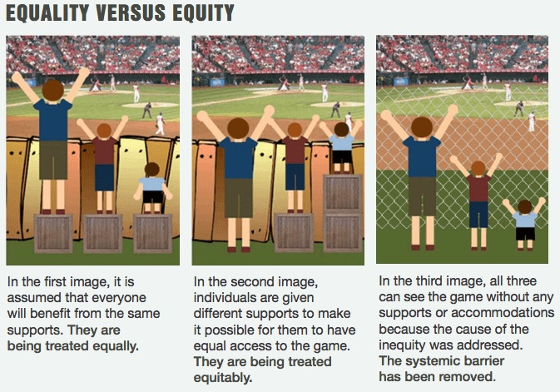

Slide 5

Compliance – Equality Act 2010crimination
The Equality Act 2010 legally protects people with protected characteristics from discrimination, harassment and victimisation in the workplace and in wider society.
It replaced previous anti-discrimination laws with a single Act, streamlining and making the law easier to understand and strengthening protection in some situations.
Can you name the nine protected characteristics?

Slide 6
Protected Characteristics
Sexual Orientation
Race
Sex
Gender Reassignment
Disability
Religion or Belief
Marriage or Civil Partnership Status
Pregnancy and Maternity
Age

Slide 7
What is Discrimination?
Direct Discrimination
This means treating one person worse than another person because of a protected characteristic. For example, a promotion comes up at work. The employer believes that people’s memories get worse as they get older so doesn’t tell one of his older employees about it, because he thinks the employee wouldn’t be able to do the job.
Indirect Discrimination
This can happen when an organisation puts a rule or a policy or a way of doing things in place which has a worse impact on someone with a protected characteristic than someone without one. For example a local authority is planning to redevelop some of its housing. It decides to hold consultation events in the evening. Many of the female residents complain that they cannot attend these meetings because of childcare responsibilities.

Slide 8
Harassment
This means people cannot treat you in a way that violates your dignity, or creates a hostile, degrading, humiliating or offensive environment.
Unwanted behaviour could include:
spoken or written abuse
offensive emails
tweets or comments on websites and social media
images and graffiti
physical gestures
facial expressions
banter that is offensive to you
Victimisation
This means people cannot treat you unfairly if you are taking action under the Equality Act (like making a complaint of discrimination), or if you are supporting someone else who is doing so.
For example, an employee makes a complaint of sexual harassment at work and is dismissed as a consequence.

Slide 9
Equality Act 2010 – Public Duty
When public authorities carry out their functions, the Equality Act says they must have due regard or think about the need to:
Eliminate unlawful discrimination
Advance equality of opportunity
Foster or encourage good relations between people.

Slide 10
Equality Act 2010 and Reasonable Adjustments
The Equality Act 2010 places a duty on employers to make reasonable adjustments.
Reasonable adjustments include making changes to the way things are organised or done if they currently put Staff or Students at a substantial disadvantage.
In relation to the duty to make reasonable adjustments, the objective test requires identification of the disadvantage suffered by the employee and then consideration as to how each of the possible adjustments would be effective to remedy that disadvantage.
Only time in the Equality Act, where positive discrimination is allowed in favour of a person with Disabilities.
https://www.wlv.ac.uk/about-us/corporate-information/equality-diversity--inclusion/policies-and-governance/reasonable-adjustment-passport/

Slide 11
Case Studies Reasonable adjustments
How these cases should have been handled
Case study 1
A long-term employee was dismissed for continued lateness. The employee had multiple sclerosis. He found it difficult to arrive on time due to mobility problems.
Case study 2
The Employer refused to provide a parking space for an employee with osteoarthritis. The employer thought this adjustment was unreasonable. They believed the employee should arrive earlier for a closer parking space.

Slide 12
Case study 1
A long-term employee was dismissed for continued lateness. The employee had multiple sclerosis. He found it difficult to arrive on time due to mobility problems.
How this should have been handled
The employer should have had a meeting with the employee about why they were often late. Adjustments could then be agreed. These might include:
a later start time
flexible hours
working from home options
longer and more frequent breaks
By talking to their employee, the employer could have come to an understanding. They could have then made an action plan to provide the best working environment.

Slide 13
Case study 2
The Employer refused to provide a parking space for an employee with osteoarthritis. The employer thought this adjustment was unreasonable. They believed the employee should arrive earlier for a closer parking space.
How this should have been handled
By asking the employee to arrive earlier, the employer wrongly shifted the responsibility to the employee. The employee was being asked to make the adjustment. Making physical adaptations to the building falls under making reasonable adjustments.
Not providing enough disabled parking for employees also falls under UK Discrimination Law.
the employer should have provided the employee a dedicated parking space
if the employer felt this was unreasonable, a detailed written record should be kept
Records of unreasonable adjustment should outline why the adjustment is impractical. For example, if the adjustment affects other employees.
The employment tribunal decided this was failing to make a reasonable adjustment. The employer was found guilty of disability discrimination

Slide 14
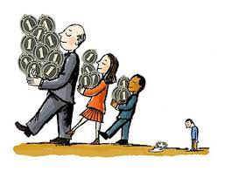
What About Socio-Economic Equality
Clauses about socio-economic equality have not been activated by the Government
Socio-Economic can include:
  Occupational Class (NS-SEC 1-3 vs NS-SEC 4-7)
  Neighbourhood Deprivation (Indexes of Multiple Deprivation)
  Engagement with Higher Education (First in Family, POLAR4)

Slide 15
Your Rights and Responsibilities
The University EDI Policy has made a clear commitment to not unfairly discriminate against anyone due to who they are or why they come from:
  “The University will not discriminate because of age, disability, gender reassignment, marriage and civil partnership, pregnancy and maternity, race (which includes colour, nationality and ethnic or national origins), religion or belief, sex or sexual orientation. It will not discriminate because of any other irrelevant factor and will build a culture that values equity, openness, fairness and transparency”
The University has also pledged to hold accountable anyone who is found to be in breach of the policy.
  “All employees and students are responsible for the promotion and advancement of this policy. Behaviour, actions or words that transgress the policy will not be tolerated and will be dealt with in line with the University’s Grievance policy and procedure”
This means that you have the right to not be unfairly discriminated against at work and the responsibility to not unfairly discriminate against anybody else.
As part of induction staff will be expected to complete two online training sessions:
Diversity
Unconscious Bias
The University of Opportunity

Slide 16

EDI Policy
Managers have a duty of care for all their staff, which includes a duty to prevent harassment, bullying and unfair discrimination taking place. Managers are required to:
Set examples and standards of behaviour in the workplace.
Ensure their staff are familiar with the EDI policy (for example during staff induction into Faculty/Directorate).
Deal with any unacceptable behaviour in their teams and make it clear to staff that such behaviour will not be tolerated.
Ensure all teams, projects and decision making are Inclusive.

Slide 17
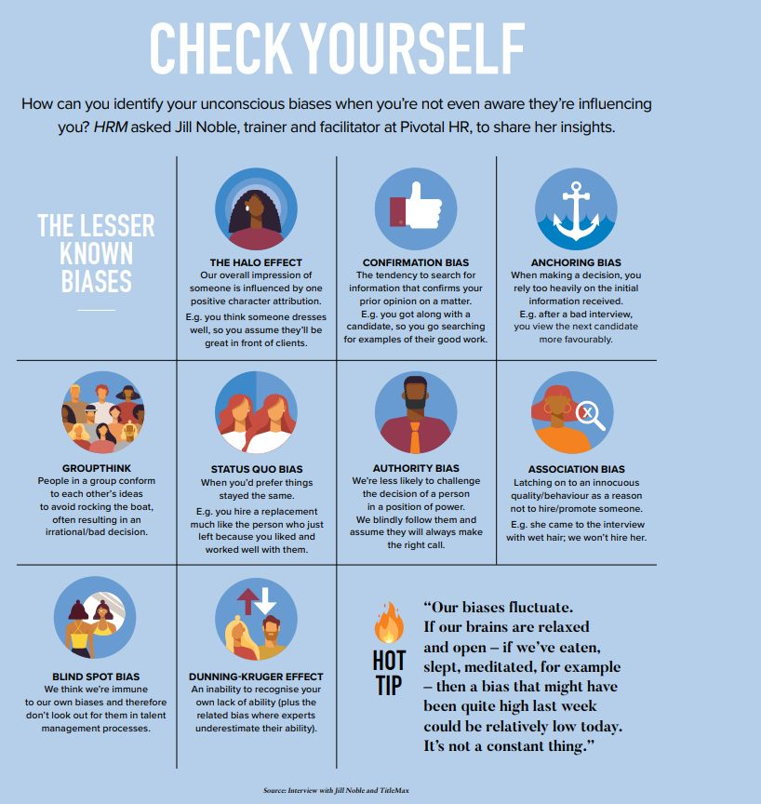

Slide 18
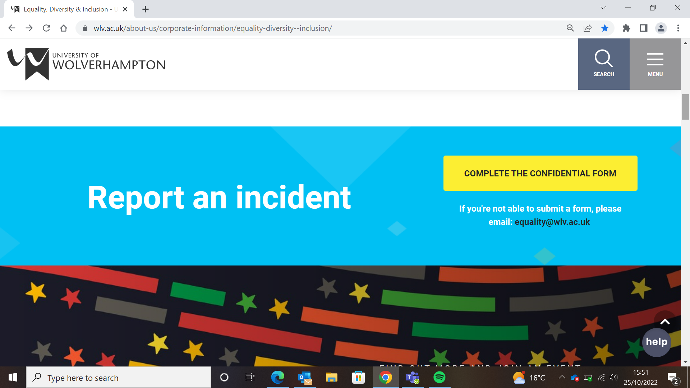
The incident reporting process has been set up to provide a confidential route to report an incident or concern of harassment, bullying, or other inappropriate behavior
This could be:
An incident that you have witnessed or an incident against yourself, either on or off campus.
Please note that this process is for non-emergency reports.
Security can be reached at any time at the following:
General Enquiries: Internal: 2106 External: 01902 322106
In an Emergency: Internal: 5555 External: 01902 322106
If you are in immediate danger, then please call 999 for the police

Slide 19
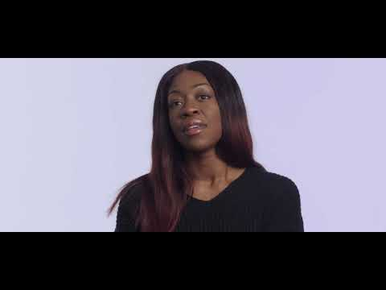
What are Micro- Aggressions, Stereotypes?
Not political correctness its respectful behaviour

Slide 20


Colour Blindness
“When I look at you, I don’t see colour”
“There’s only one race, the human race”
Message: denying a person’s racial/ethnic experience and denying the significance that this may play in their lives.
Denial
“I’m not homophobic, I have several gay friends”
Message: Because I have friends who are gay I can’t be homophobic

Slide 21

EDI
Going beyond the law -The Big Picture

Slide 22
Our vision is to create an inclusive work and study environment by:
Identifying and addressing Institutional, structural and cultural inequalities to ensure both staff and students can reach their full potential.
Ensuring all staff and students are treated with respect and dignity in a safe environment.
Creating a diverse Workforce that reflects local demographics and our student population, at all levels within the University
Utilising and valuing the diverse skills, experience and knowledge of our staff and students.

Slide 23

Creating Inclusive workplaces – Your role
Be yourself – be your professional authentic self. Be brave enough to show up at your workplace. ...
Speak up about inclusion. ...
Think about how you communicate. ...
Respond from a place of personal experience. ...
Challenge stereotypes. ...
Support your co-workers' differences.

Slide 24
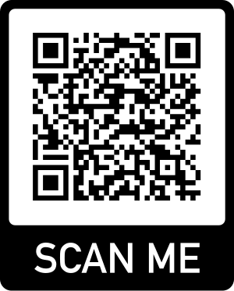
Are you an inclusive leader?
https://www.catalyst.org/wp-content/uploads/2022/03/Are-you-an-Inclusive-Leader_032822.pdf

Slide 25

Why be an inclusive leader?
While many workforces are diversifying, not all of them are taking advantage of their diverse talent. Inclusive leaders help their organizations in many ways, including:
Giving a voice to everyone on the team
Increasing employee happiness by making them feel valued
Helping their team adapt to changes quickly
Increasing efficiency by utilizing everyone's best abilities
Inclusive leaders are people who work to get everyone on the team involved. They not only like hearing new ideas from different people but they are willing to try them out.

Slide 26
Shares own development
Shares
Experiences
Facilitates growth conversations
No Hierarchy
Active Listening
Role Model
Shares their legacy
Communication
Demonstrates behavioural
change
Model positive behaviours
Atmosphere of
trust
Inclusive Leadership Principles
Shares the
bigger picture
Other Traits
Constructive
Considers
Career Growth
Feedback
Reliable
Open
Knows Individual Strengths
Decisive
Awareness of own strengths and
weaknesses
Understands Team Dynamics

Slide 27
Key Traits of Inclusive Leaders
Empathy:
Understanding and sharing the feelings of others. Inclusive leaders show genuine concern for their team members' well-being and experiences.
Self-Awareness:
Being aware of one’s own biases and actively seeking to mitigate their impact. Inclusive leaders continually reflect on their behaviour and its effects on others.
Commitment to Diversity:
Actively promoting and valuing diversity within the team. Inclusive leaders take deliberate steps to ensure diverse perspectives are represented and heard.
Courage:
Willingness to challenge the status quo and address inequalities. Inclusive leaders stand up against biases and advocate for fair treatment.
Cultural Competence:
Understanding and effectively interacting with people from different backgrounds and lived experiences. Inclusive leaders educate themselves about different cultural norms and practices.
Notes:
Font Avenir Next Lt Pro
Size 12
Colour palette Blue II
Master slide includes both logos
Introduce myself - Director of Diversity & Inclusion at the University of Wolverhampton. 25 years of experience in the education sector from early years, through to primary, senior leadership, working with secondaries and FE colleagues, into HE and through my own studies, with a Masters in inclusive education where I will soon complete (he says) my professional doctorate in education focusing on developing cultural competence.

Slide 28

Leadership is about recognising the diverse skills, knowledge and lived experience your staff have and then utilising those skills to build stronger inclusive teams that lead to better performance and productivity.

Slide 29
What does inclusivity mean to you?
How does my department
model inclusivity?
What can my department do better?

Slide 30
TO BUILD AN INCLUSIVE WORKPLACE -You have the power—and responsibility—to lead with inclusion. Six core behaviours foster an inclusive culture:
LEADING - OUTWARD Your ability to bolster team members’ capacity to be empowered, treated fairly, and flourish at work. ACCOUNTABILITY Hold team members responsible for their behaviour, development, and work processes. OWNERSHIP Guide them to solve their own problems and make their own decisions. ALLYSHIP Actively support people from underrepresented groups. | LEADING - INWARD Your ability to act courageously, learn, and self-reflect. CURIOSITY Proactively seek to understand different points of view. HUMILITY Take ownership for mistakes and learn from missteps. COURAGE Act in accordance with your principles, even when it involves personal risk-taking or is uncomfortable.

Slide 31
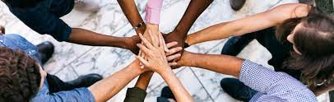
How to make teams more inclusive
Create an organisational culture that reflects inclusivity. ...
Encourage inclusive language. (Inclusive language aims to treat people with respect and avoid offense. It does that by avoiding words and certain expressions that exclude, stereotype, discriminate, or assign negative connotations to personal characteristics of certain people and communities)....
Make spaces comfortable for all. ...
Create a friendly work environment. ...
Incorporate a culture of appreciation. ...
Create opportunities for interaction.

Slide 32
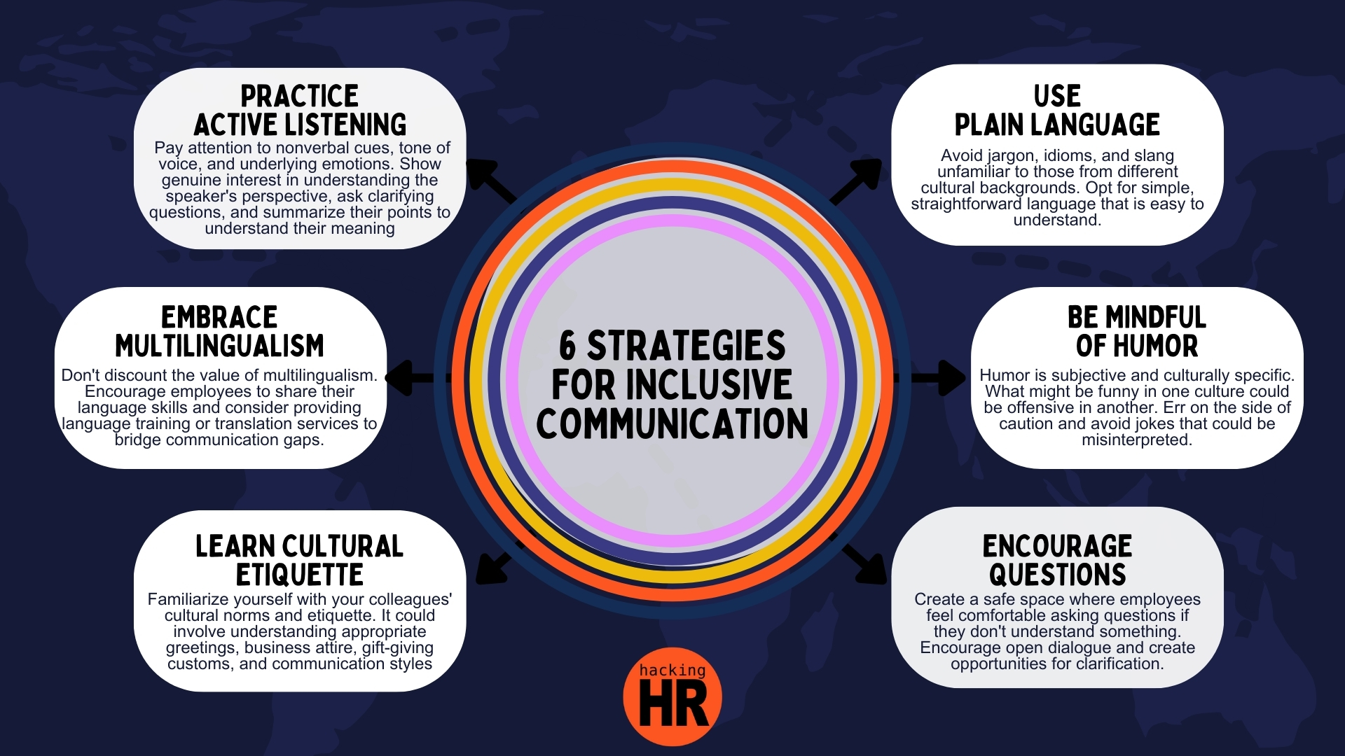

Slide 35





THE IMPACT - AN INCLUSIVE WORKPLACE/TEAMS
Your employees will experience being:
VALUED
They are appreciated and respected for their unique perspectives and talents
TRUSTED
They make meaningful contributions and are influential in decision-making.
AUTHENTIC
They can bring their full selves to work and express aspects of themselves that may be different from their peers.
PSYCHOLOGICALLY SAFE: LATITUDE
They feel free to hold differing views and make mistakes without being penalized.
PSYCHOLOGICALLY SAFE: RISK-TAKING
They feel secure enough to address tough issues or
take risks

Slide 36
Cultural Competency Quiz
How about a cultural competency quiz? How much do you really know about cultural competency? Cultural competence, which is also known as intercultural competence, is a range of cognitive, affective, and behavioural skills that cause effective and appropriate communication with people of different cultures.
These questions in the quiz will test you on how well you understand cultural competency. All the best to you with the test and have fun too.
https://www.avma.org/sites/default/files/2022-02/DiversityCulturalCompetenceChecklist.pdf

Slide 37

Cultural Competency
Cultural Competency: Create spaces for dialogue and reflection within your teams.
It is important to note that ‘culture’ as is being referred to here, means every person’s unique lived experience and is not solely focused on issues of race and ethnicity.
‘Cultural competence is the art of embracing the richness of diverse voices, understanding the depth of different lived experiences, and engaging with the world through a lens of empathy and respect…
It requires a commitment to learning, unlearning, and relearning with an open heart and mind, ensuring that our interactions are inclusive, equitable, and informed by the tapestry of human diversity.’
(Vasco, 2023)
Notes:
Font Avenir Next Lt Pro
Size 12
Colour palette Blue II
Master slide includes both logos
Introduce myself - Director of Diversity & Inclusion at the University of Wolverhampton. 25 years of experience in the education sector from early years, through to primary, senior leadership, working with secondaries and FE colleagues, into HE and through my own studies, with a Masters in inclusive education where I will soon complete (he says) my professional doctorate in education focusing on developing cultural competence.

Slide 38
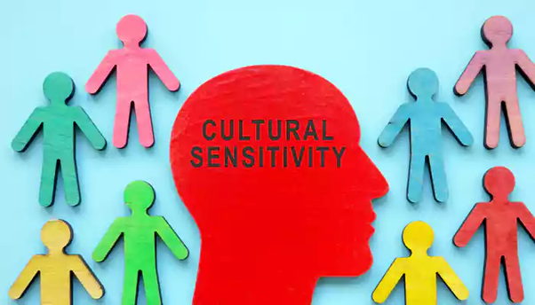
Cultural sensitivity is:
being aware that there are cultural differences between individuals and groups.
understanding that cultural differences can have an impact on people’s behaviors and communication styles.
being respectful and non-judgmental towards other cultures.
being curious and open to learning about other people's cultures.
being culturally sensitive means having the capacity to function effectively in other cultures. It is valuing and respecting diversity and being sensitive to cultural differences.

Slide 39

Ways to Develop Your Cultural Sensitivity
Learn about other cultures. Attend cultural festivals and events and get to know people with unique backgrounds. Educate yourself about other cultures, especially the cultures of people you work closely with.
Avoid making assumptions. Preconceived ideas of how someone from a particular background is supposed to behave or think can be harmful.
Reflect on your own biases. Be aware of how your own biases may influence your perceptions of other cultures.
Practice empathy. Try to understand people's experiences from their perspective.

Slide 40

Ways to Demonstrate Cultural Sensitivity
Listen actively. It’s important to open the doors of communication if your colleagues want to share their thoughts and experiences in the workplace with regard to their culture.
Be open-minded. By approaching different cultures with a spirit of curiosity and flexibility, you get to enjoy new experiences.
Respect boundaries. Be mindful of people's personal space, privacy, and cultural practices.
Communicate clearly. Avoid using expressions that may not be familiar to others from different culture

Slide 41
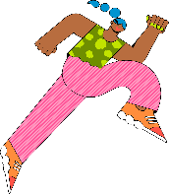





Developing Cultural Competence to Enhance Students’ Sense of Belonging
Cultural Sensitivity:
What It Looks Like:
Leaders start to understand and address the specific needs of diverse team members.
Policies begin to reflect an awareness of diverse cultural backgrounds and experiences.
Example:
Adjusting meeting times and formats to accommodate diverse team schedules and needs.
Addressing microaggressions promptly and sensitively within the team.
Notes:
Font Avenir Next Lt Pro
Size 12
Colour palette Blue II
Master slide includes both logos
Introduce myself - Director of Diversity & Inclusion at the University of Wolverhampton. 25 years of experience in the education sector from early years, through to primary, senior leadership, working with secondaries and FE colleagues, into HE and through my own studies, with a Masters in inclusive education where I will soon complete (he says) my professional doctorate in education focusing on developing cultural competence.

Slide 42
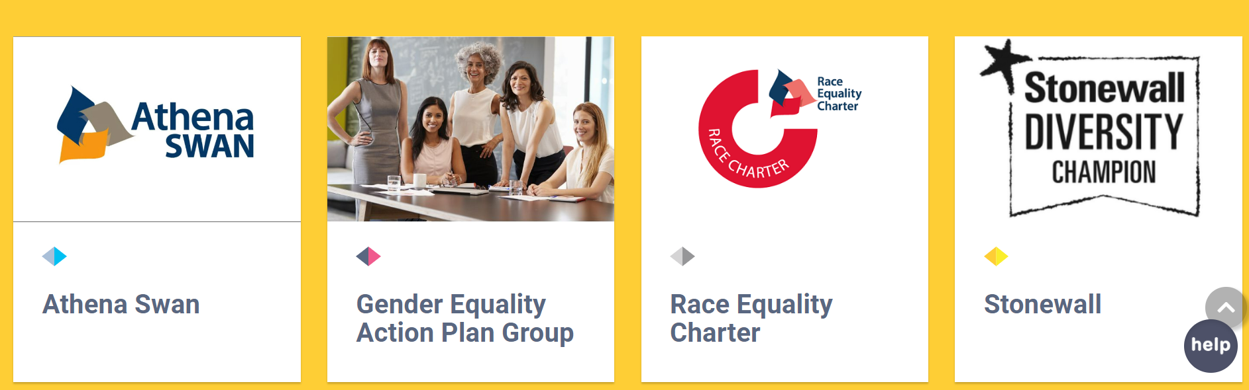
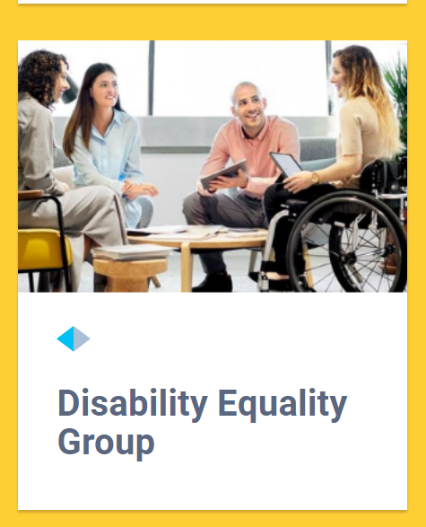

Our Initiatives
Athena Swan - Bronze
  Gender Equality Action Delivery Group
Race Equality Charter - Bronze
  RECAP Delivery Group
Disability Equality Group
  DEAP Delivery group
Stonewall

Slide 43
A sharing campaign – ‘Disability is everyone's business’ was launched in September 2023
A toolkit for managers on flexible working and guidance on Menopause & Menstruation in the workplace, has been drafted.
Guidance for staff on disability related leave or sickness absence and managing cancer in the workplace, has been developed.
The Incident reporting tool: This was launched in May 2021. Regular reports and data is presented to various committees. Since the launch of the tool, there have been over 85 reports with 78 reports resolved. 3 pending and 3 flagged.

Slide 44
Action Taken
Guidance on positive action
Reasonable Adjustment passport
Guidance/policy for religious observance in the workplace has been drafted.
The Shap Calendar of religious events, is available to view on EDI webpages
Reverse Mentoring: A successful reverse mentoring pilot programme (action in REC) for global majority staff and students was delivered and evaluated. The programme is now being rolled out to junior staff and students from all protected characteristics to mentor senior staff members.

Slide 45

INCLUSION
Everyone is included and feels valued. Where all are treated with dignity and respect.

Slide 46
Any Questions?
Thank You

